Slide 1
CUDA AND IMPLEMENTATION ON ROS

Slide 2
OUR SCHEDULE
Session 1 : Revision Yolo and OpenCV
Quick Flashback on Phase 2
Session 2: Installation OF CUDA
Grouping
Check Device
Download and install CUDA
# DAY 1

Slide 3
Revision on YOLO and OpenCV
Session 1

Slide 4
YOLO

Slide 5
Test Image

Slide 6


Testing Model
Tiny YOLOv3
To use this model, first download the weights:
Then run the detector with the tiny config file and weights:
./darknet detect <config-file-path> <weight-file-path> <Image-file-path>

Slide 7
TEST ON WEBCAM
./darknet detector demo cfg/coco.data cfg/yolov3.cfg yolov3-tiny.weights
./darknet detect demo <config-file-path> <weight-file-path>

Slide 8
OpenCV

Slide 9
Blurring

Slide 10
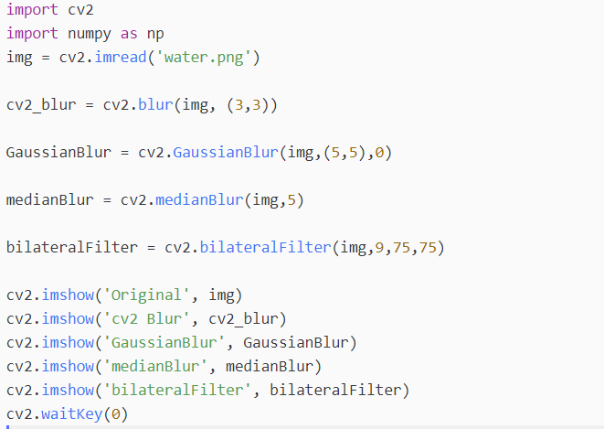

Slide 12
Colourspace

Slide 13
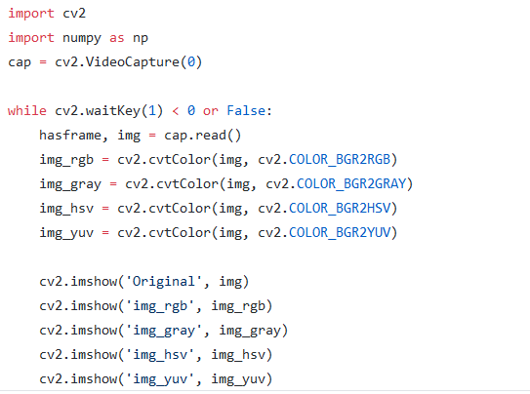

Slide 14
Edge

Slide 15
Task
Show me the four different Edge on image and webcam

Slide 16
Drawing
Task
Write “Revision” on the image / webcam

Slide 17
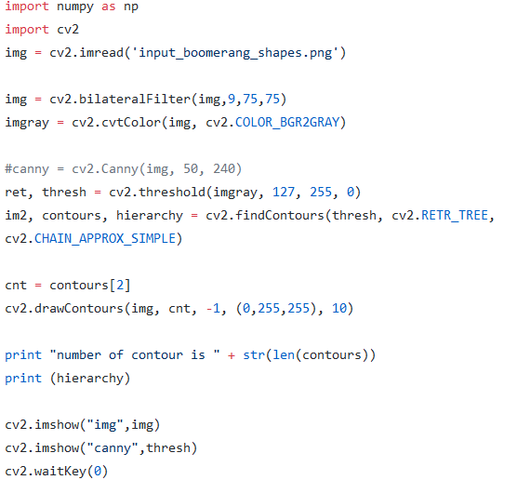
Contour

Slide 18

INSTALLATION ON CUDA

Slide 19


Why not AMD DEVICE / Intel Integrated Device ?
AMD has ROCm which is similar however, not many framework support it.
https://github.com/RadeonOpenCompute/ROCm
*Not recommended
----------------------------------------------------------
For Intel, OpenVINO is provided but similar situation as well

Slide 20

Conclusion
Use Nvidia CUDA is easier since got many support and examples online.

Slide 21
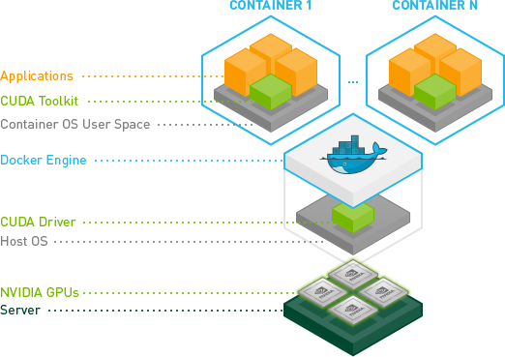
Nvidia Docker (Only For Online)
The NVIDIA Container Toolkit allows users to build and run GPU accelerated Docker containers. The toolkit includes a container runtime library and utilities to automatically configure containers to leverage NVIDIA GPUs.
Advantages:
Easy to install
Use it on multiple devices
Disadvantages:
Requires internet
Hard to debug

Slide 22
Nvidia Devices
https://developer.nvidia.com/cuda-gpus
First, check whether your device have Nvidia GPU
$ lspci | grep -i nvidia
BACKUP FIRST
For those who don’t have Nvidia GPU, may group with with others
One group 5-8 person

Slide 23
Requirement
Table 1. CUDA Toolkit and Compatible Driver Versions
CUDA Toolkit | Linux x86_64 Driver Version
CUDA 10.1 (10.1.105) | >= 418.39
CUDA 10.0 (10.0.130) | >= 410.48
CUDA 9.2 (9.2.88) | >= 396.26
CUDA 9.1 (9.1.85) | >= 390.46
CUDA 9.0 (9.0.76) | >= 384.81
CUDA 8.0 (8.0.61 GA2) | >= 375.26
CUDA 8.0 (8.0.44) | >= 367.48
CUDA 7.5 (7.5.16) | >= 352.31
CUDA 7.0 (7.0.28) | >= 346.46

Slide 24
Installation Step
In a new terminal
sudo apt-get install linux-headers-$(uname -r)
sudo apt-get install openjdk-8-jdk git python-dev python3-dev python-numpy python3-numpy build-essential python-pip python3-pip python-virtualenv swig python-wheel libcurl3-dev curl
curl -O http://developer.download.nvidia.com/compute/cuda/repos/ubuntu1604/x86_64/cuda-repo-ubuntu1604_10.0.130-1_amd64.deb
sudo apt-key adv --fetch-keys http://developer.download.nvidia.com/compute/cuda/repos/ubuntu1604/x86_64/7fa2af80.pub
sudo dpkg -i ./cuda-repo-ubuntu1604_10.0.130-1_amd64.deb

Slide 25
Installation Step
sudo apt-get update
sudo apt-get install cuda-10-0
sudo reboot
nvidia-smi

Slide 26
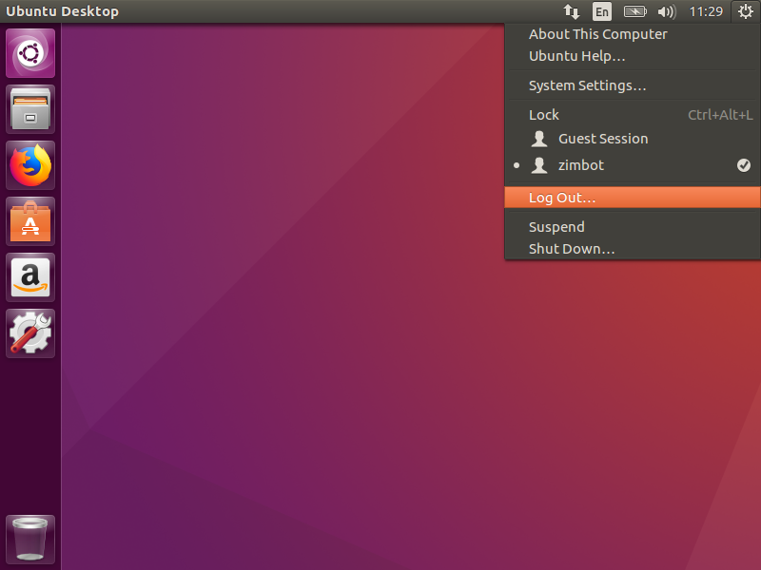
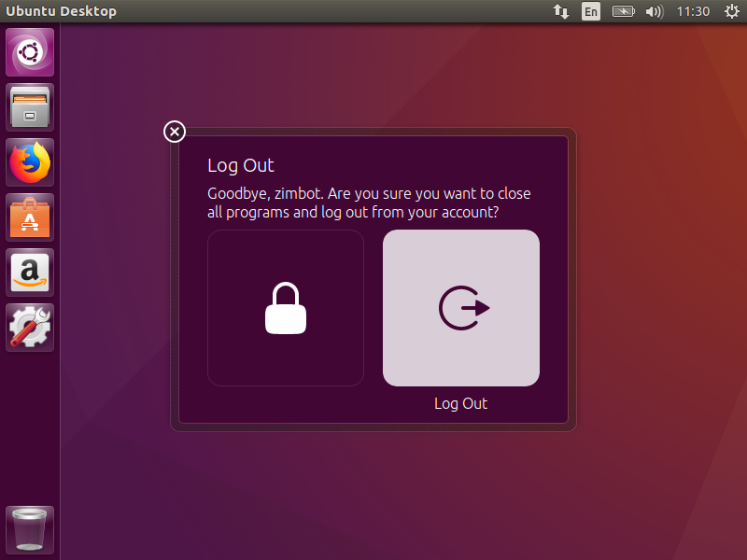
*If failed, follow these steps
Log out

Slide 27
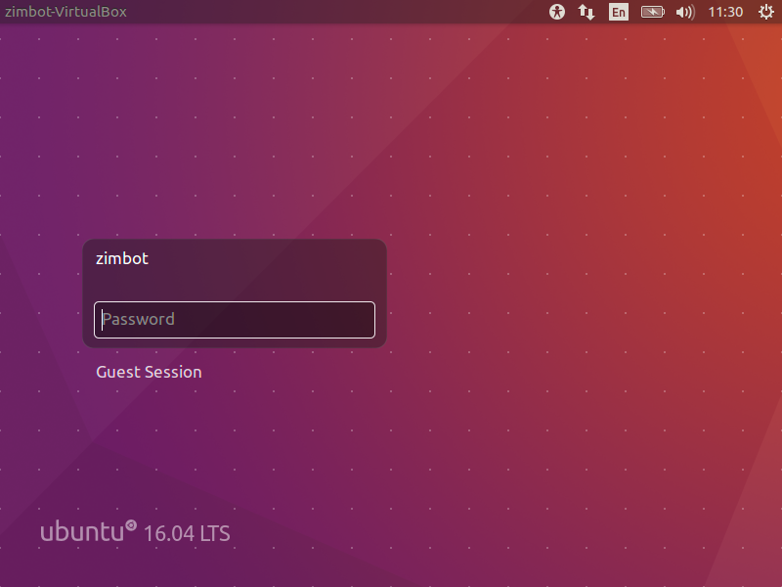
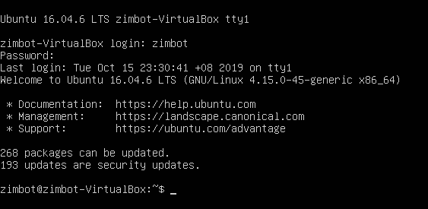
Alt + Ctrl + F1 Login using username and password

Slide 28
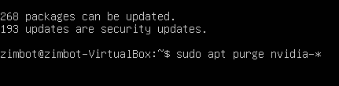
sudo apt purge nvidia-*

